Slide 1
Covid-19 driven nationwide lockdown affects zooplankton community structure in River Ganga at Patna
Ram Kumar
Dean School of Earth. Biological and
Environmental Sciences
Central University of South Bihar

Slide 2
Graphical Abstract

Slide 3
Introduction
The Gangetic river Dolphin is mainly solitary and non social, once in a while found in little gatherings.
Prey accessibility, water quality and volume are restrictive factors for their abundance.
An indicator species for the river ecosystem, being at the apex of the food chain

Slide 4
The distribution and ecology of dolphins is affected by several abiotic and biotic factors (Canadas et al., 2002; Yen et al., 2004; Tynan et al., 2005),
However, the ecological field studies of dolphins become challenging.
The task is to observe and count dolphins while simultaneously measuring physical variables and plankton and fish abundance at relevant spatial and temporal scales (Croll et al., 2005).

Slide 5
Govt. of India declared nation wide lock down on 24 March 2020, limiting movement of the entire 1.3 billion population of India as a preventive measure against the COVID-19 pandemic in India.
Lock down completely stopped industrial units and people’s movement, some reports suggested that dolphins started appearing at many sites and self purification machinery of the ecosystem started functioning optimally in the absence of human intervention.
The short term changes in the aquatic ecosystems can be reflected in changes in zooplankton community structure.
Zooplankton are reliable indicators of the aquatic ecosystems
They show immediate response to changes in its ambient environment in terms of relative abundance, functional groups and production of resting stages.

Slide 6
They constitute the food base for many invertebrates, their developing stages and larval fish,
They are an important driver of community structures in aquatic ecosystems (Cohen et al., 2003; Roy, 2007; Nautiyal, 2010
The zooplankton community was represented by diverse feeding groups including herbivores, carnivores, detritivores and bacterivores

Slide 7
Objectives
The short term changes in the aquatic ecosystems can be reflected in changes in zooplankton community structure.
Zooplankton are reliable indicators of the aquatic ecosystems
They show immediate response to changes in its ambient environment in terms of relative abundance, functional groups and production of resting stages.

Slide 8
To elicit the impact of the current lock down - we compared zooplankton abundance, diversity and community structure of zooplankton
OBJECTIVE:
To elucidate the effects of Covid-19 forced lock down on Zooplankton community: absolute and relative abundance and fractions of functional feeding groups.
Comparison of data recorded during the current lock down with data recorded during 2018 and 2019 in our time series study as part of our DBT sponsored project (BT/PR20543/BCE/8/1398/2016)

Slide 9
Methods
Monthly zooplankton samples were collected at both the sampling sites using 53 µm mesh size plankton net since January 2018 by filtering 45-50L of river water.
Zooplankton were immediately fixed in 4% buffered formalin.
Zooplankton were identified to the lowest possible taxa and segregated on the basis of taxonomic and functional feeding groups.

Slide 10
Water samples:
Through routine monitoring of water quality of river ganga at selected sites in Patna, we studied the impact of lockdown on the quality of Ganga river water and zooplanktonic diversity at selected site
During each sampling, the water samples were also collected to monitor other microbial and chemical properties
Total coliform
Fecal coliform
Dissolved oxygen
BOD
COD, TSS & TDS

Slide 11
Study Area

Slide 12
Results
The parameters indicating high level of river pollution have subsided during the lockdown period.
Amount of dissolved oxygen has increased significantly
While those of COD, BOD, total suspended solid (TSS), total dissolved solid (TDS), recorded decreasing trend
Total coliform (TC) as well as faecal coliform (FC) records significantly decreased values.

Slide 15
Zooplanktonic diversity
Zooplanktonic diversity shows increasing trends after starting of lockdown at both of the site.
Cladoceren abundance is increasing as the lockdown is extended,
The rotifer abundance decreases,
While TC and FC also records decreasing during the lockdown.
The results indicate that the bottom up effect might be working as Dolphins are spotted more frequently during the lock down.

Slide 16
Bottom up Effect
Dolphin
Aquatic community in river Ganga
Fishes
Juvenile fishes
Rotifer
Cladocerens
TC/FC
Phytoplankton

Slide 17
Zooplankton Abundance at Anta Ghat

Slide 18
Species richness

Slide 19
Zooplankton Abundance

Slide 20
Species richness

Slide 22
Acknowledgements:
DBT,Govt of India for the project (BT/PR20543/BCE/8/1398/2016)
Prof. C. R. Babu, University of Delhi, for guidance to continue study during lock down and compare the data with previous years
Dr. Dilip Kumar for consistent guidance during the project work
Research Scholars; Kumar Rajan, Anant and others

Slide 23
References
Roy, S. P., Roy, R., Prabhakar, A. K., Pandey, A., Kumar, R., & Tseng, L. C. (2013). Spatio-temporal distribution and community structure of zooplankton in the Gangetic Dolphin Sanctuary, 2009. Aquatic Ecosystem Health & Management, 16(4), 374-384.
Canadas, A.R., Sagarminga, R., Garcia-Tiscar, S., 2002. Cetacean distribution related with depth and slope in the Mediterranean waters off southern Spain. Deep-Sea Research I 49 (11), 2053–2073.
Yen, P., Sydeman, W.J., Hyrenbach, K.D., 2004. Marine bird and cetacean association with bathymetric habitats and shallow-water topographies: implications for trophic transfer and conservation. Journal of Marine Systems 50 (1/2), 79–99.
Tynan, C.T., Ainley, D.G., Barth, J.A., Cowles, T.J., Pierce, S.D., Spear, L.B., 2005. Cetacean distribution related to ocean processes in the northern California Current System. Deep-Sea Research I 52 (1/2).
Croll, D.A., Marinovic, B., Benson, S., Chavez, F.P., Black, N., Ternullo, R., Tershy, B.R., 2005. From wind to whales: trophic links in a coastal upwelling system. Marine Ecology Progress Series 289, 117–130.
Down to earth (Wednesday 15 April 2020) https://www.downtoearth.org.in/news/wildlife-biodiversity/covid-19-lockdown-a-blessing-for-the-endangered-gangetic-dolphin-in-bihar-experts-70470

Slide 24
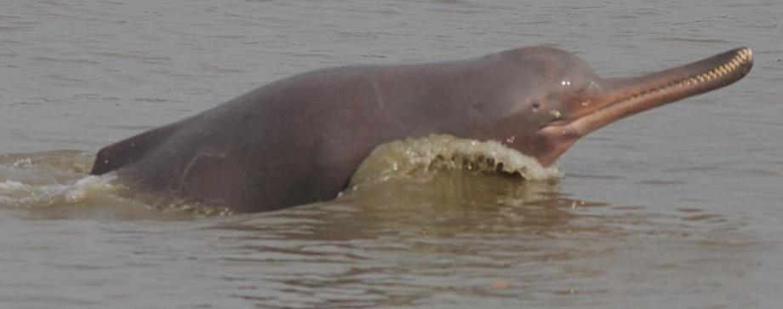
Thank you for your attention
Prof. Ram Kumar
ramkumar@cub.ac.in;
ecosystem.kumar@gmail.com

